Slide 1


MokCyberSecure
PROG6221 Mokwena Kgaogelo
ST10450091
A cybersecurity Awarenes Bot

Slide 2
Project Objectives
The goal of the project is to build a cybersecurity awareness bot that is voice integrated, It educates users and help them stay safe through an engaging, real time conversation
KEY OBJECTIVES
Educate users about common cybersecurity topics
Using text to speech to make it more understanderble to users and keep the conversation friendly
Improves safety practices

Slide 3
Why this matters
Common Cyberattacks like Phishing, Safe browsing, Weak passwords have affected a lot of people on a daily basis. So this project was created to bridge the gap between users that don’t know how to respond and fall victims of this scams
MokCyberSecure brigdes the gap by:
Helping and educating users to make smart and safe decisions
Making it user-friendly for easy accessebility

Slide 4
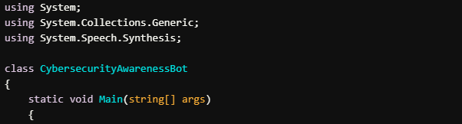
Features and code explanations
Class Definition
class CybersecurityAwarenessBot:
This defines a class named CybersecurityAwarenessBot, which serves as the main container for the program.
Main Method
static void Main(string[] args): This is the entry point of the application. When the program runs, execution starts here.

Slide 5
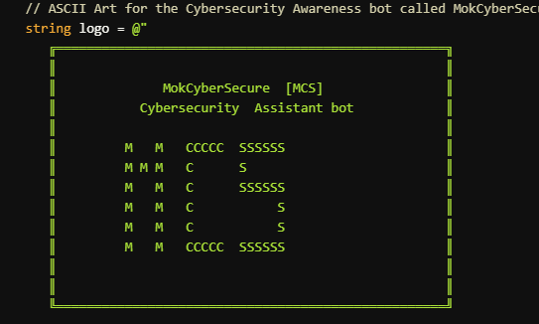
ASCII Art
string logo = @"...": This section defines a string variable named logo, which contains ASCII art. The art represents a logo for the
bot named "MokCyberSecure" along with its abbreviation "[MCS]" and a tagline "Cybersecurity Assistant bot".

Slide 6
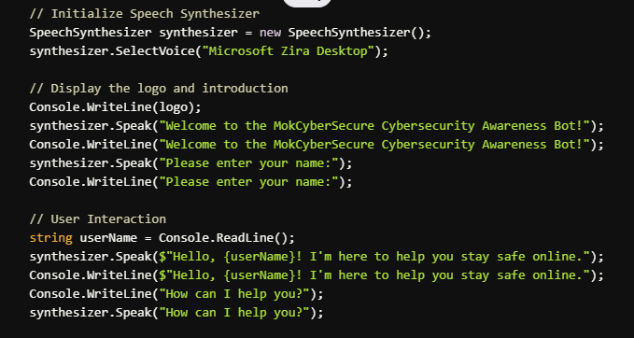

Slide 7
SpeechSynthesizer synthesizer: This initializes the speech synthesizer, which will allow the bot to "speak" to the user.
synthesizer.SelectVoice("Microsoft Zira Desktop"): This selects the voice used by the bot. In this case, it's a default voice called Microsoft Zira Desktop
Console.WriteLine(logo);: This displays the ASCII logo to the console.
synthesizer.Speak(): The bot speaks a welcome message using the Speech Synthesizer.
Console.WriteLine(): The bot also writes the same message to the console for the user to read.
The bot asks the user to enter their name both in text and speech.

Slide 8
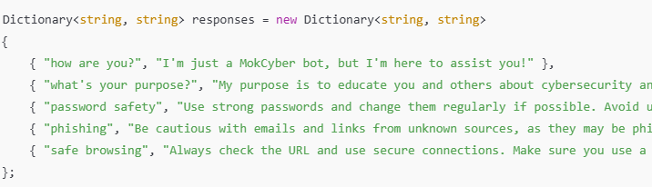
string userName = Console.ReadLine();: This prompts the user to enter their name and stores it in the userName variable.
synthesizer.Speak() and Console.WriteLine(): The bot speaks and writes a personalized greeting that includes the user's name.
• Dictionary<string, string> responses: This creates a dictionary (key-value pairs) to store questions and their corresponding answers.
o Keys: Different topics like "how are you?" or "password safety".
o Values: The answers related to those topics.

Slide 9
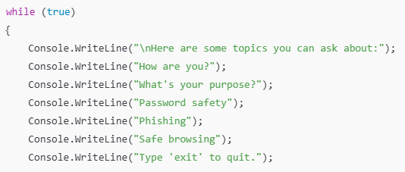
while (true): The loop keeps the bot running until the user decides to exit.The bot shows a list of topics that the user can ask about, such as "How are you?", "What's your purpose?", etc.

Slide 10
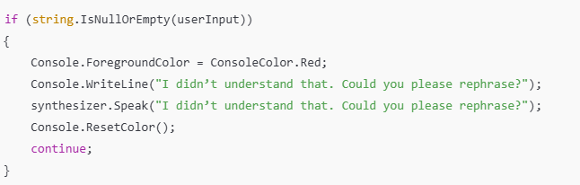
Input Validation: If the user doesn't provide any input (an empty string or null), the bot asks the user to rephrase. The message is shown in red to indicate an error.continue;: The program loops again, prompting the user for input.

Slide 11
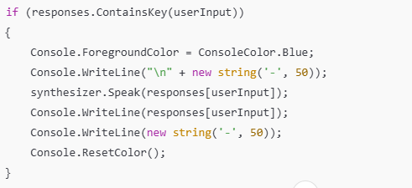
If the user's input matches a key in the responses dictionary, the bot:
Changes the text color to blue.
Prints a border for neatness.
Speaks the corresponding response using synthesizer.Speak().
Displays the response on the console.
Resets the text color to default.

Slide 12
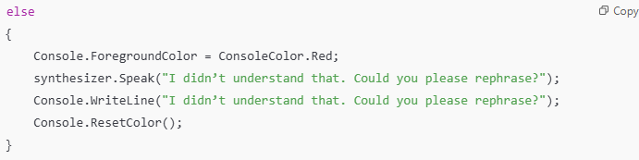
If the user's input doesn't match any key in the dictionary, the bot will prompt the user to rephrase their input (shown in red).
The program will continue to run until the user types "exit". Once "exit" is typed, the bot thanks the user and closes the application.

Slide 13
Conclusion
This Cybersecurity Awareness Bot informs people about cybersecurity subjects in an interactive manner.
It uses speech synthesis for speaking responses.
A dictionary for storing predefined replies.
Provide error handling for incorrect inputs.
It's a simple yet effective technique to educate consumers about internet safety while keeping the learning
process interesting.

